Slide 1


Slide 2

VIT
Topic/Course
Sub-Topic (Example: name of college)

Slide 3

Geometry

Slide 4
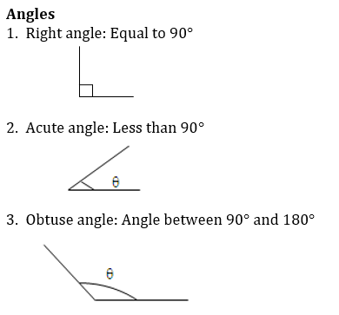
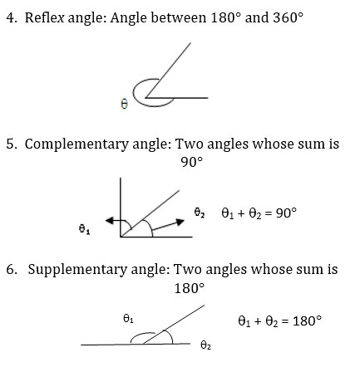

Geometry

Slide 5
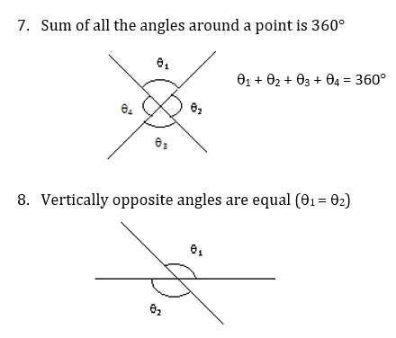
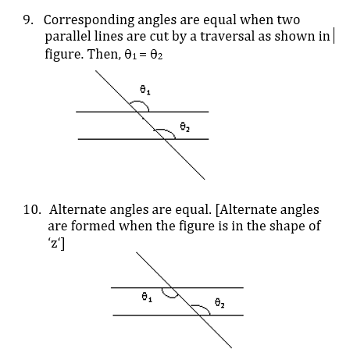
Geometry

Slide 6
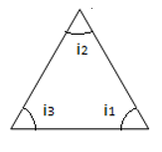
Geometry
External and Internal angles:
Polygon: Any closed figure is called a polygon. Minimum three sides are required to form a polygon.
Regular polygon: All the sides and angles are equal. For any polygon, Number of vertices is equal to the number of sides.
Interior angle: In any regular polygon, the sum of interior angle is 180°.
Here i1,i2 and i3 are the interior angles of a triangle.

Slide 7
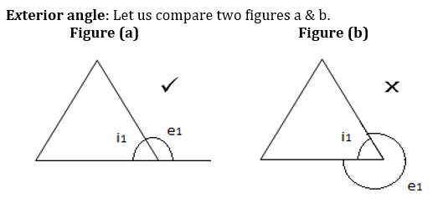
Geometry
Exterior angle is supplementary but not reflexive. Hence the angle formed by projecting a side to another side
of the polygon is called exterior angle. So, Figure b is incorrect.
From exterior angle, we can find the interior angle. Because,
Interior angle + Exterior angle = 180°.

Slide 8
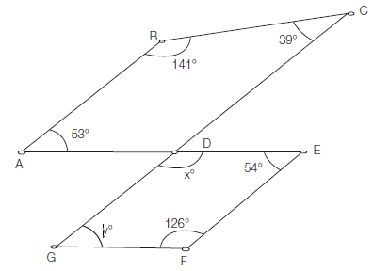
Question 1
In the following figure, find x and y, if AB ll CG and AE ll GF.
A)
127°, 53°
B)
125°, 55°
C)
130°, 50°
D)
145°, 35°
Notes:
Answer: A
We know that the sum of internal angles of any quadrilateral = 360°. Now, in quadrilateral ABCD 53° +141° + 39° +∠CDA = 360°⇒∠CDA = 127° Now, ∠CDA = ∠EDG (Vertically opposite angles are equal). Therefore, x = 127°. Also, ÐDGF = ÐBAD (AE || GF). Therefore, y = 53°.

Slide 9
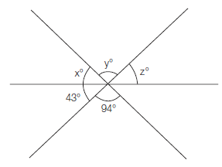
Question 2
Find x, y and z in the following figure.
A)
45°, 55°, 80°
B)
42°, 94°, 44°
C)
48°, 54°, 78°
D)
43°, 94°, 43°
Notes:
Answer: D
We have ∠y = 94° (QVertically opposite angles) ∠z = 43° (QVertically opposite angles) Also, x° + y° + z° = 180°. When we solve for x, we get x = 43°.So, the answer is 43°, 94°, 43°.

Slide 10
Question 3
ABC is an equilateral triangle with side 6 √3. Find the radius of incircle and circumcircle to the triangle.
A)
4, 6
B)
3, 6
C)
4, 2
D)
4, 3
Notes:
Answer: B
We have Radius of incircle = a / 2√3 = 6√3 /2√3 = 3 Radius of Circumcircle = a /√3= 6√3/ √3 = 6

Slide 11
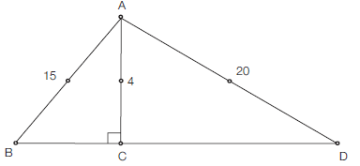
Question 4
In the triangle below if AB | AD, find BD.
A)
25
B)
22
C)
23
D)
20
Notes:
Answer: A
Pythagoras theorem: AB | AD. Hence, AB² + AD² = BD²BD = 25.

Slide 12
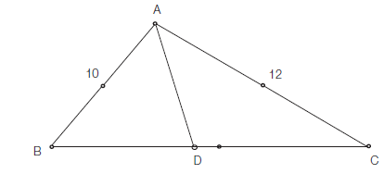
Question 5
Find AD if AD is the median of the triangle ABC.
BC = 16
A)
√55
B)
√57
C)
√58
D)
√60
Notes:
Answer: C
Drop a perpendicular AE to BC. Now, let us have BE = x, ED = 8 - x and EC = 16 - x (1) AE² = AB² - BE² = AC² - EC² (2) Substituting Eq. (1) in Eq. (2), we get BE = 6.625 and ED = 1.375 Also, AE² = AB² - BE² = 100 - 43.9 = 56.1 Now, in triangle AED AD² = AE² + ED² = 56.1 + 1.9 = 58 Hence, AD = √58

Slide 13
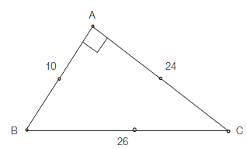
Question 6
Find the inradius and circumradius of the triangle given below.
A)
4, 13
B)
5, 13
C)
6, 14
D)
2, 15
Notes:
Answer: A
Images: View->Notes page
Area of triangle ∆ABC = (1/2) * 10 * 24 = 120
Also note that

Slide 14
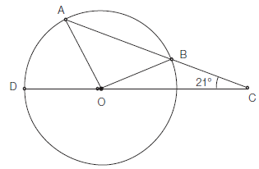
Question 7
If OB = BC, find ∠AOB.
A)
95°
B)
96°
C)
92°
D)
99°
Notes:
Answer: B
We have ÐCOB = ÐBCO = 21° (Q OB = BC) Therefore ÐOBC = 138°. Now ∠OBC +∠OBA = 180°⇒∠OBA = 42° Also ∠OBA = ∠OAB = 42° and ∠OBA +∠OAB +∠AOB = 180° So ÐAOB = 96°.

Slide 15
Question 8
Two chords are drawn in the circle such that one chord is 24 cm away from the centre and other is 10 cm away from the centre. If the radius of the circle is 26 cm, find the length of the chords.
A)
49 cm, 24 cm
B)
48 cm, 20 cm
C)
45 cm, 48 cm
D)
44 cm, 24 cm
Notes:
Answer: B
Images: View->Notes page

Slide 16
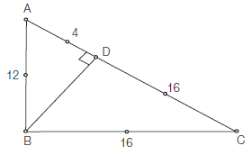
Question 9
Find BD in the following figure.
A)
12.3
B)
11.3
C)
13.3
D)
12.2
Notes:
Answer: B
In triangle ABD, AB² = AD² + BD² Hence, BD²=12² - 4² = 128 BD = 11.3

Slide 17
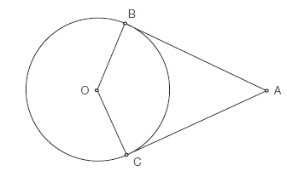
Question 10
Find the area of the quadrilateral ABOC, given that the diameter of the circle is 20 cm and AB = 18 cm.
A)
185 cm²
B)
180 cm²
C)
179 cm²
D)
178 cm²
Notes:
Answer: B
Image: View->Notes page

Slide 18
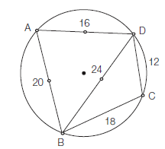
Question 11
Find AC in the figure below.
A)
25
B)
22
C)
23
D)
26
Notes:
Answer: B
Note that, in cyclic quadrilateral d₁d₂ = Sum of the products of opposite sides Therefore BD x AC = AD x BC + AB x DC 24 x AC = 16 x 18 + 20 x 12=> 24 x AC = 288 + 240 => AC = 22

Slide 19
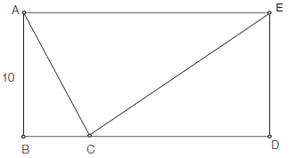
Question 12
Find the ratio of the areas of the triangle ACE to the area of the rectangle if the area of the rectangle is 160 sq. units.
A)
1/2
B)
2/3
C)
3/4
D)
4/3
Notes:
Answer: A
Area of the ABCD = AB * AE
160 = 10 * AE
AE = 16 Now Area of ΔACE = 1/2 x 16 x10 = 80 Therefore, Area of ΔACE = 80 = 1 Area of rectangle ABCD 160 = 2Required ratio = 1/2.

Slide 20
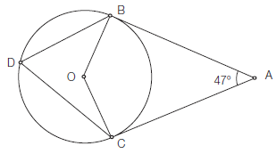
Question 13
Find BDC from the figure below where AB and AC are tangent to the circle at points B and C, respectively.
A)
65°
B)
66.5°
C)
63°
D)
69°
Notes:
Answer: B
Since AB and AC are tangents to the circle, therefore OB | AB and OC | AC. Also OBA = 90° and OCA = 90°. Now BOC + 90° + 90°+ 47° = 360° Therefore BOC = 133° and BDC = 66.5° (Q angle made by sector at centre is twice the angle made by it at any point on the circle.)

Slide 21
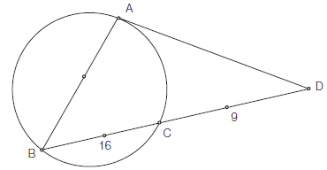
Question 14
Find the length AD if AD is the tangent to the circle.
A)
12
B)
13
C)
14
D)
15
Notes:
Answer: D
We have AD² = DC * DB = 9 * 25 = 225 AD = 15

Slide 22
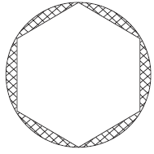
Question 15
Find the area of the shaded region if the radius of the circle is 10 cm and the side of the regular hexagon is 6 cm.
A)
100π - 54 √3
B)
100π - 52 √3
C)
100π - 50√ 3
D)
99π - 54√ 3
Notes:
Answer: A
Images: View->Notes page
Area of the circle = πr² = π(10)² = 100π The hexagon can be divided into 6 triangles as below Area of hexagon = 6 * Area of equilateral triangle with side 6 = 6(√ 3/4) * 6 * 6 = 54 √ 3 So Area of the shaded portion = Area of circle - Area of hexagon = 100π - 54 √3

Slide 23

THANK YOU

